Slide 1

Chapter 3: Making Things Move
Introduction to Web Development
YNC Hacks
Software Track

Slide 2
01
02
AGENDA
RESPONSIVE DESIGN
ANIMATIONS

Slide 3

Responsive Design
Responsive design is the process of creating web pages that are able to look good regardless of the screen size of the client

Slide 4
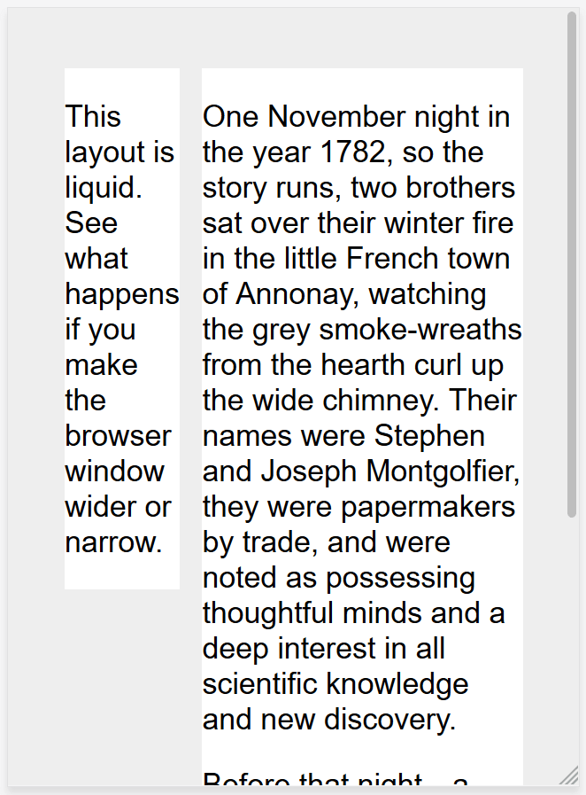
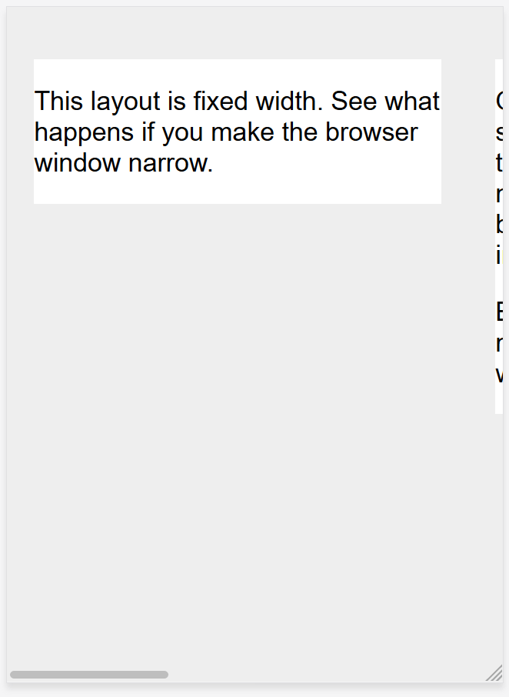
Old School Websites

Slide 5
Media Queries
Responsive design was able to emerge due to media queries.
Media queries are CSS code that can check for the screen size of the client’s device before applying styles.

Slide 6
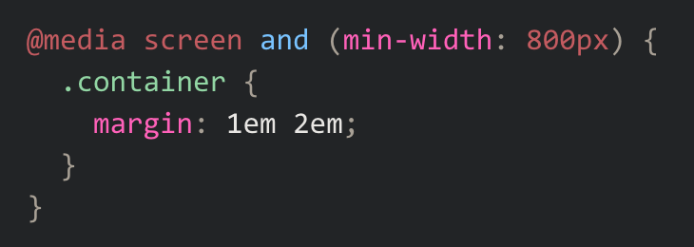
Media Queries
Checks for:
Screen display (not printed document)
Screen width of 800px

Slide 7

Try it out!

Slide 8
Animations
Animations can be done using CSS to manipulate certain properties when an event happens.
Can be done either using the transition property or @keyframes rule

Slide 9

ADD THEM TO YOUR HOMEPAGE!

Slide 10
PROJECT 3
Welcome
How the Web Works
Setting Up
File Management
Basic HTML
You can continue working on your home page!
Implement these skills:
Responsive design
Animations
Before your dive in, remember the importance of having a design first before you start coding!
Note: Make sure your animations also work for different screen sizes!

Slide 11
THANK YOU
Welcome
How the Web Works
Setting Up
File Management
Basic HTML
Repository: https://github.com/leonardtng/introduction-to-web-development
Do you have any questions?
Some content in these slides are adapted from developer.mozilla.org

